Slide 1
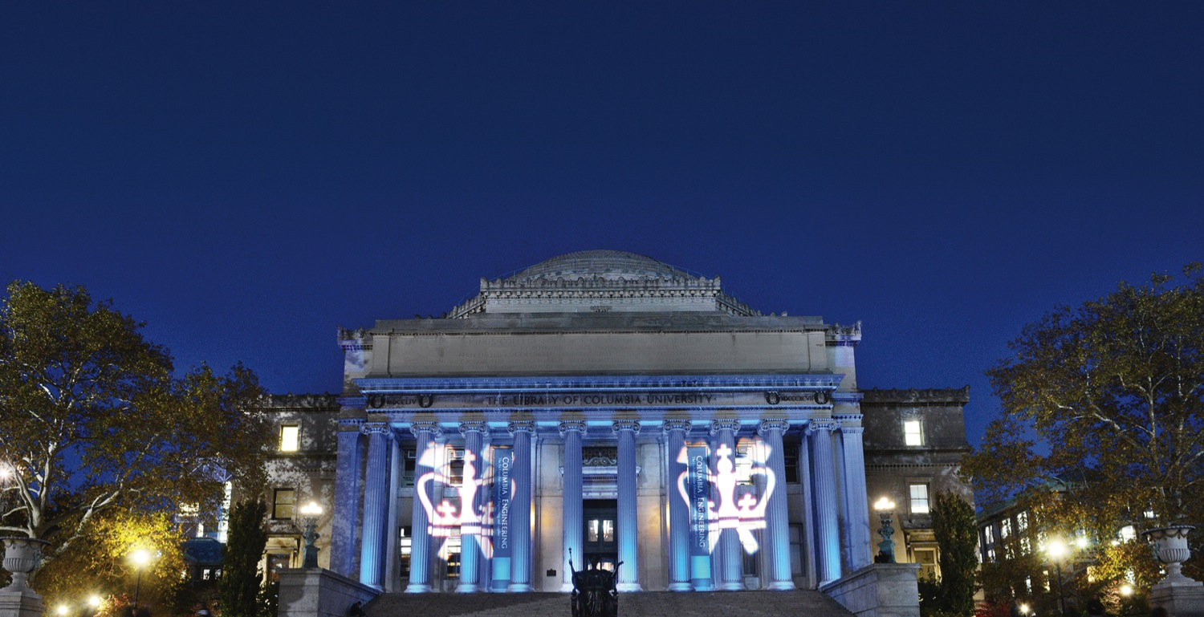
Detecting breast cancer metastases in gigapixel pathology images
By Jiaying Chen
TRANSCENDING DISCIPLINES, TRANSFORMING LIVES
Notes:
Hi, everyone. I’m Jiaying Chen. Today I am going to talk about my project, detecting breast cancer metastases in gigapixel pathology images.
My presentation is divided into 5 parts, including introduction, data preprocessing, modeling, results and code walkthrough.

Slide 2
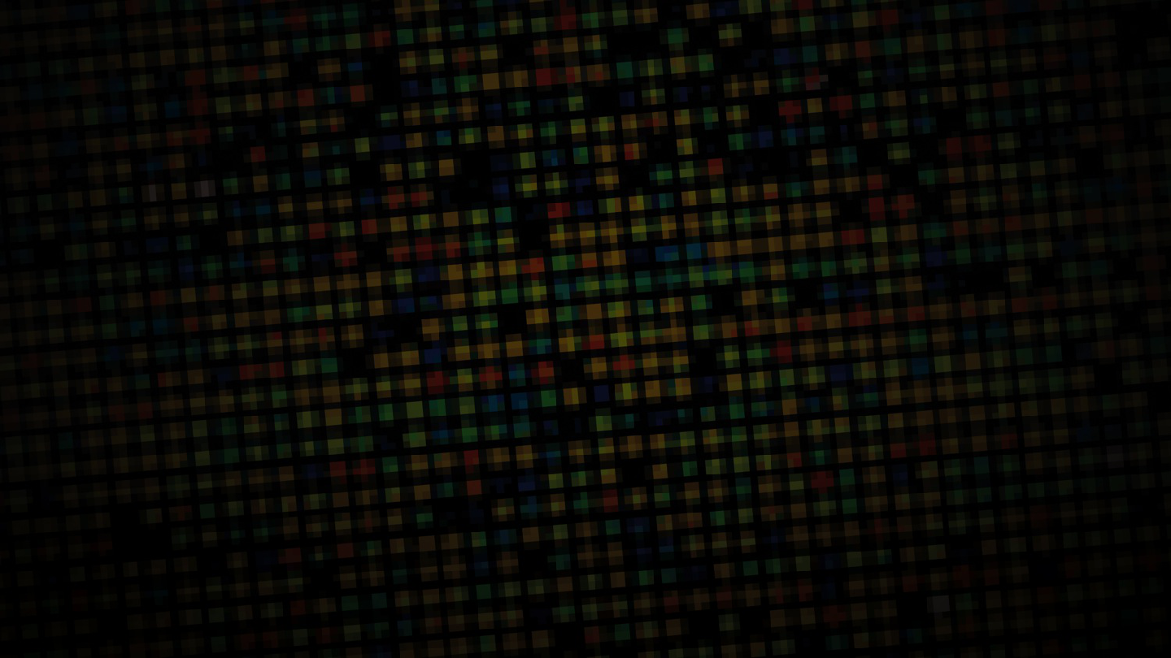
Introduction
1 | Introduction
Notes:
First, let me start with a quick introduction to this project.

Slide 3
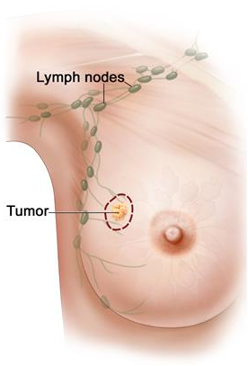
Background
This project focuses on the detection and classification of breast cancer metastases in lymph nodes.
But it’s time-consuming, and most importantly, small metastases are very difficult to detect and sometimes they are missed.
https://camelyon17.grand-challenge.org/Background/
1 | Introduction
Notes:
This project focuses on the detection and classification of breast cancer metastases in lymph nodes. But in the real world, the detection is much time-consuming, and most importantly, small metastases are very difficult to detect and sometimes they are missed.

Slide 4
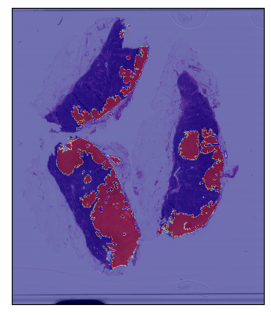
Goal
The goal of this project is to build a model for automated detection and classification of breast cancer metastases in whole-slide images of histological lymph node sections.
1 | Introduction
Notes:
So it’s necessary to build a model as an auxiliary tool for automated detection and classification of breast cancer metastases in whole-slide images of histological lymph node sections

Slide 5
Data Preprocessing
2 | Data Preprocessing
Notes:
I’d now like to move on to the next part, data preprocessing

Slide 6
Data preprocessing
1. Loading slides and tumor masks
2. Exacting patches from slides
(From scratch vs. Tensorflow)
( Level 2 vs. Level 3 )
3. Data Augmentation
2 | Data preprocessing
Notes:
In this section, there are 3 steps for data preprocessing. The first one is loading slides and tumor masks from google drive or google cloud. And the second step, the most important step, exacting patches from slides and tumor masks. I tried to use two different methods to deal with raw data, one is doing everything from scratch, the other one is applying tensorflow. And the last step is data augmentation.

Slide 7
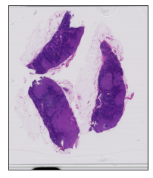
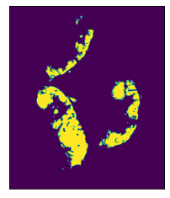
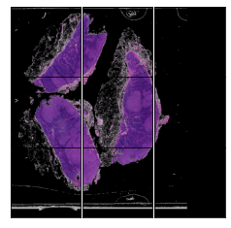
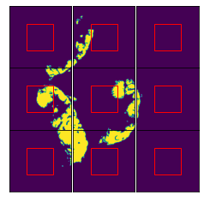
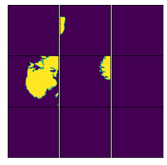
Exacting patches – Visualization
Inputs
Labels
2 | Data preprocessing
Notes:
Before I start talking about details about exacting patches. I’d like to give you a clear visualization on how to exact patches from the slide and the tumor mask, here is an example of tumor 078 at level 7. In the left, it’s the process for the slide. Sliding a fixed-size window from left to right, from top to bottom, then we can get 9 patches in this example. The right side is the process for the tumor mask which is the same as that in the left part. But there is one more thing that need to do, that is, cropping the center region of each patch as its label., that is the region in the red square. If the central region exists tumor, it would be set to positive, otherwise, that would be negative. After that, we can get inputs and labels for the model.

Slide 8
Exacting patches – Tensorflow
tf.image.extract_patches on slides and tumor masks to get (299, 299) for each patch
tf.image.central_crop on tumor masks to the central 50%
Much faster
1. Need to read the entire slide at first, it would crash when level comes to 2.
2. Need transfer the shape all the time to fit in the functions in Tensorflow
Pros
Cons
https://www.tensorflow.org/api_docs/python/tf/image/extract_patches
https://www.tensorflow.org/api_docs/python/tf/image/central_crop
2 | Data preprocessing
Notes:
The first method I used for exacting patches is applying Tenrsoflow. Here, the function ‘extract patches’ is used for splitting slides and masks into patches, and in order to get labels from tumor masks, the function ‘central crop’ would be helpful, it would crop the central 50% of the image. These are two main functions for this method.
It should be emphasized that this method is fast, but it would run out of RAM. It need to read the entire slide into RAM at first, and when load only one slide at level 2, Colab would crash due to using all avaliable RAM. And another disadvantage of this method is that it need transfer the shape of the tensor all the time to fit into different functions in Tensorflow.

Slide 9
Exacting patches – Scratch
Set all pixels whose intensity are less than 0.8 to (0,0,0)
Sliding windows -> Exacting patches (299,299) for slides and tumor masks
For masks, get the label from the center part (128, 128) of the patch
Data cleaning: Dropping patches that are all black
1. Don’t need to read the entire slide into RAM, save space
2. It can easily downsample on negative examples
Much slow
Pros
Cons
2 | Data preprocessing
Notes:
The second method is exacting patches from scratch. For this part, I also did some extra data cleaning. Let me illustrate what I did. First of all, I set all pixels whose intensity is less than 0.8 to (0,0,0), that is black. In this step, it would remove all non-tissue part in the slide. The second step and the third step are similar to that in the above method. The only different is that I did it by sliding the central point of each patch in the image to get patches, and get the label from the central region (128, 128) of the patch. Finally, I also dropped all patches that are all black, because there are no useful features to exact from these kind of patches.
Compared to the above method, this method is much slower. But it can deal with larger slides without crashing.

Slide 10
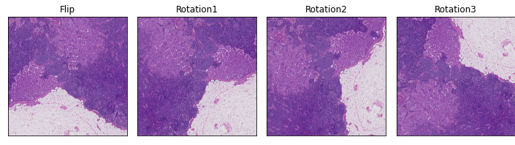
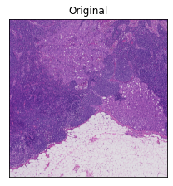
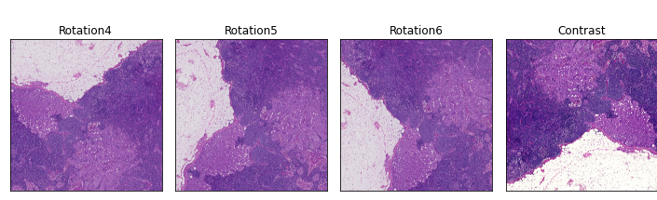
Data Augmentation
https://www.tensorflow.org/api_docs/python/tf/keras/layers/experimental/preprocessing
2 | Data preprocessing
Notes:
In order to mitigate the effect caused by class imbalance, it’s need to oversample on positive examples. For each slide, the number of patches containing tumor is much less than that do not. So I tried 8 different types of augmentations, like flip, rotation and contrast.

Slide 11
Model
3 | Model
Notes:
Now let’s turn to the model I used for this project.

Slide 12
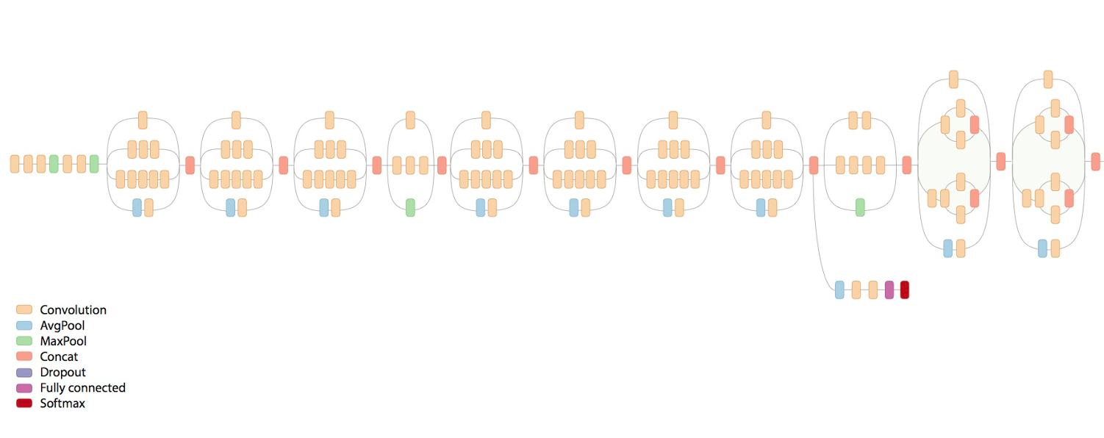
Architecture of the model
Inception V3
Classifier
Fine tunning
Flatten
2 | Data preprocessing
Notes:
The following is the architecture of the model I used. The inception v3 is the base model used for exacting meaningful features, and a new classifier is added to the end of the base model, that is, a flatten layer, a dropout layer, a dense layer, and another dropout, dense layer, then a softmax layer in the last for binary classification. What’ more, considering images in this project are different from that used for training Inception, it’s need to fine tuning the last few layers in the base model.

Slide 13
Results
4 | Results
Notes:
Then let’s move on to the results I got from the model.

Slide 14
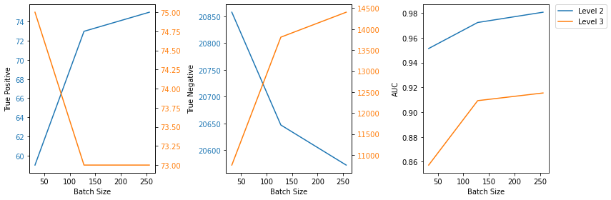
Results on the validation dataset
Batch Size | Level 2 (From scratch) |  |  | Level 3 (Tensorflow)
 | Confusion Matrix |  | AUC | Confusion Matrix |  | AUC
32 | 59 | 113 | 0.9514 | 75 | 6028 | 0.8573
 | 51 | 20858 |  | 0 | 10758
128 | 73 | 324 | 0.9724 | 73 | 2977 | 0.9093
 | 37 | 20647 |  | 2 | 13809
256 | 75 | 399 | 0.9807 | 73 | 2382 | 0.9155
 | 35 | 20572 |  | 2 | 14404
Level 2: Batch ↑ -> TP ↑, TN ↓, AUC ↑
Level 3: Batch ↑ -> TP ↓, TN ↑, AUC ↑
A Simple Framework for Contrastive Learning of Visual Representations
4 | Presentation Title Presentation Title
Notes:
Here is the results on the validation dataset got from two methods.
The intuition of evaluating the model on different batch size is that I got the idea that increasing batch size benefits the contrastive learning from this paper. So I also think the larger batch size would be helpful for this so imbalanced data.
Let me use these graphics to explain this. As the batch size increases, so does AUC.
For level 2, the number of TP is increasing but that of TN is decreasing. But for level 3, the result is the opposite.
So for tradeoff, I choose 128 as the best batch size for this model

Slide 15
Results on the test dataset
Method | Level | TPR | TNR | AUC
From scratch | 2 | 0.5648 | 0.9927 | 0.9786
Tensorflow | 3 | 1.0000 | 0.6120 | 0.8828
From scratch: TNR -> 1
Tensorflow: TPR -> 1
From scratch: Deleting patches that are all black
From scratch > Tensorflow
AUC
Deal with more smaller patches in one slide
Tensorflow: No data cleaning -> much more imbalance
4 | Presentation Title Presentation Title
Notes:
Next, let me explain results on the test set.
One key point here is the difference between the result got from scratch and that from applying tensorflow. For the first method, TNR approaches to 1, but for the second, that is TPR approaches to 1. What makes the difference is the difference in the data cleaning part. The model applying Tensorflow would tend to predict all patches as positive examples. So it won’t be much meaningful for automated detection.
In conclusion, either from the value of AUC or from the size and the number of patches, the method from scratch is better than the other one.

Slide 16
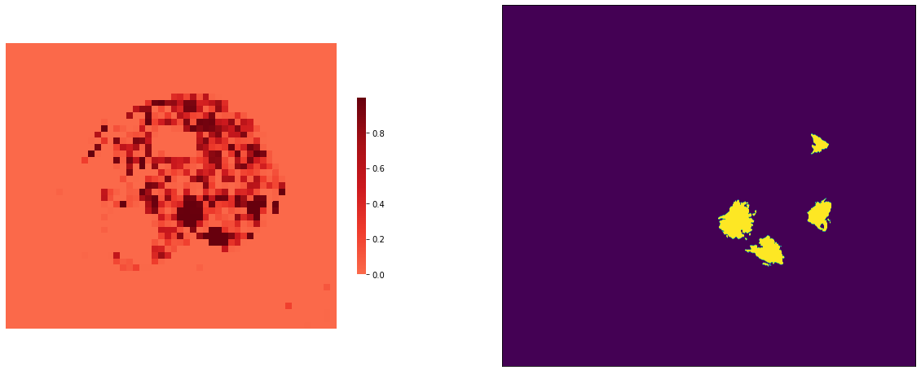
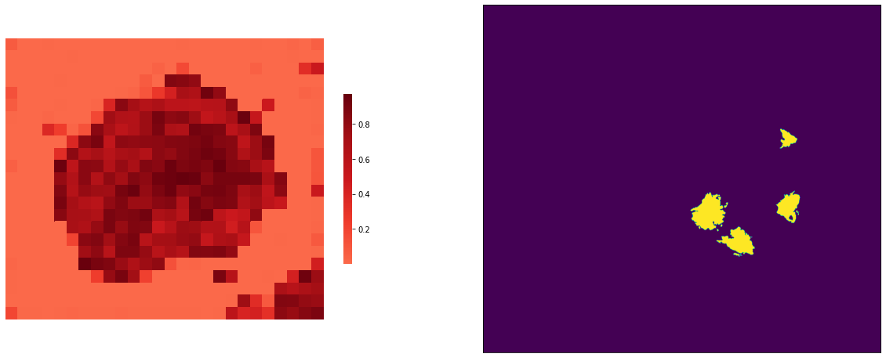
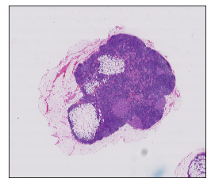
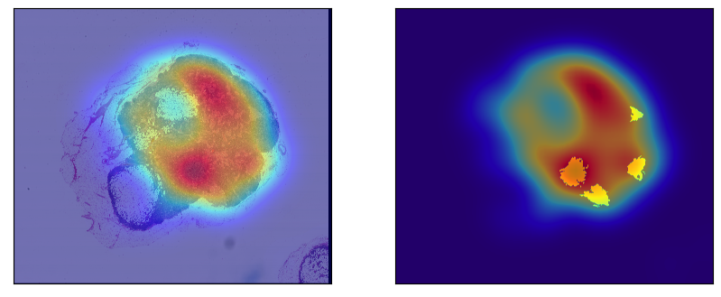
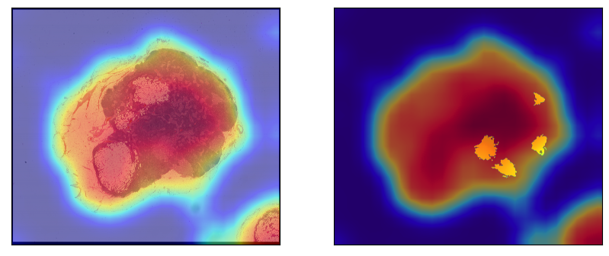
Visualization on the whole slide – level 2 vs. level 3
Original
Level 2
Level 3
4 | Results
Notes:
I’d like to show the result of detection and classification by giving you these heatmaps.
The red region in this heatmap means that there exist tumors.
Comparing these heatmaps can also prove that the method from scratch for level 2 is better than the other one.

Slide 17
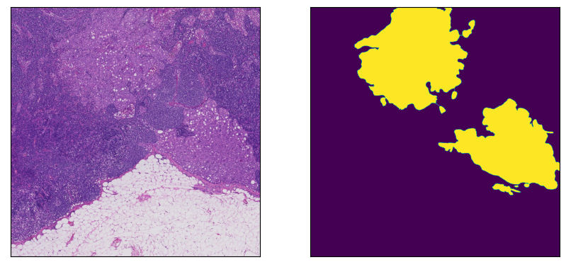
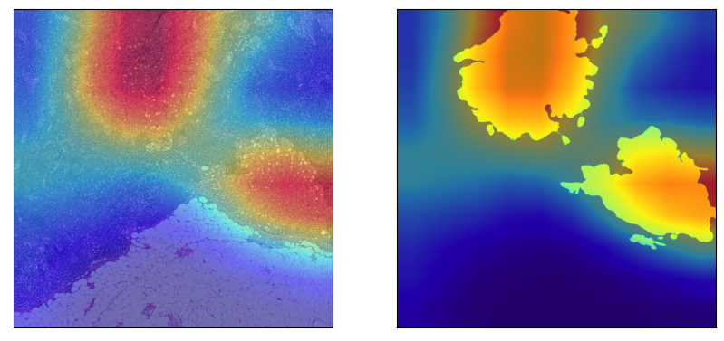
Visualization on the details at level 2
4 | Presentation Title Presentation Title
Notes:
Then let me elaborate further on the details of the result.
This one is the part of the slide, the corresponding part of the mask, and the heatmaps on that part. It’s clear to see that the model can detect tumors accurately.

Slide 18
Code Walkthrough
5 | Code Walkthrough
Notes:
Finally, let’s walkthrough the code I wrote.

Slide 19
Links of code
From scratch
https://github.com/JiayingChen36/Tumor-Detection-in-whole-slide-images-of-histological-lymph-node-sections-/blob/main/Detection_Tumor_From_Scratch.ipynb
Tensorflow
https://github.com/JiayingChen36/Tumor-Detection-in-whole-slide-images-of-histological-lymph-node-sections-/blob/main/Tumor_Detection_Tensorflow.ipynb
5 | Code Walkthrough
Notes:
Here are two jupyter notebooks, each one is associated with one method.

